Slide 1
COMPUTER ARCHITECTURE ( Mid-terms)
資工二 111110536 劉健明

Slide 2
What is a RISC-V?
RISC-V (pronounced "risk-five") is a free and open ISA for processors based on RISC principles, which are designed to make processors more efficient by reducing the number of instructions they need to execute. RISC-V can be used to design processors for a variety of applications, from microcontrollers to high-performance servers and has been supported by a number of organizations, including universities, companies, and research institutions.

Slide 3
RISC vs CISC
RISC is a computer architecture philosophy proposed in the 1980s as an alternative to the commercial architectures offered at the time by Intel, Motorola, and pretty much everyone else. Originally dubbed as "Complex Instruction Set Computer," or CISC, this architecture relied on dense instruction sets to implement a wide variety of operations thought to be useful and necessary. However, many research teams including IBM and UC Berkeley found that compilers usually ended up using a very small subset of these complex instruction sets. This, and other findings, led to questioning the need for a larger instruction set, focusing on simplicity as a means to improve efficiency.
Overall, RISC is the opposite of CISC in many ways. Usually, CISC central processing units (CPUs) have a few registers and lots of instructions, most of which have access to memory, whereas RISC CPUs have lots of registers and a very modest instruction set, with memory access restricted to a few load and store instructions.

Slide 4
Here is the difference between RISC and CISC
RISC
CISC
Emphasis on hardware
Multiple instruction sizes and formats
Less registers
More addressing modes
Extensive use of microprogramming
Instructions take a varying amount of cycle time
Pipelining is difficult
Emphasis on software
Instructions of same set with few formats
Uses more registers
Fewer addressing modes
Complexity in compiler
Instructions take one cycle time
Pipelining is easy

Slide 5
History
The RISC-V ISA was developed at the University of California, Berkeley, beginning in 2010. The goal of the project was to create a free and open alternative to proprietary ISAs used in many processors. The RISC-V ISA is based on established RISC principles, which are designed to make processors more efficient by reducing the number of instructions they need to execute.
The first version of the RISC-V ISA was released in 2011, and it has since undergone several updates and extensions. In addition to the core ISA, RISC-V includes a number of optional extensions for tasks such as vector processing and atomic operations.
Until this day RISC-V has gained significant traction in both academia and industry, and it is now supported by a number of organizations, including universities, companies, and research institutions. It is used in a variety of applications, from microcontrollers for IoT devices to high-performance processors for servers.

Slide 6
Architecture
The RV12 RISC V architecture is shown below. The RV12 is highly configurable with a single-core RV32I and RV64I compliant RISC CPU which is used in embedded fields. The RV12 is also from a 32 or 64-bit CPU family depending on the industrial standard RISC-V instruction set.
The RV12 simply executes a Harvard architecture for simultaneous access to instruction as well as data memory. It also includes a 6-stage pipeline which helps in optimizing overlaps in between the execution as well as memory accesses to improve efficiency. This architecture mainly includes Branch Prediction, Data Cache, Debug Unit, Instruction Cache, & optional Multiplier or Divider Units.

Slide 7
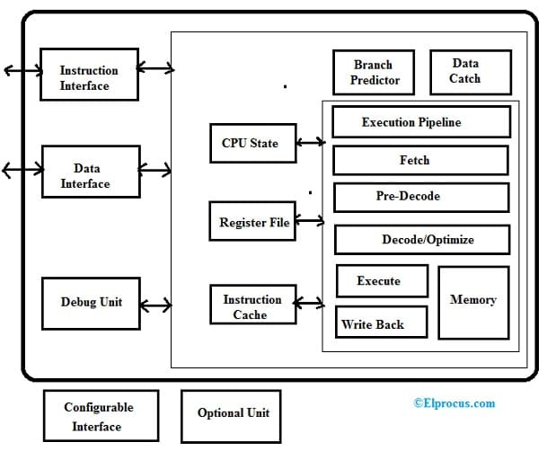
It's pipeline include five stages like IF (instruction fetch), ID (instruction decode), EX (execute), MEM (memory access) & WB (register write-back).
In Instruction Fetch or IF stage, a single instruction is read from the program counter (PC) and instruction memory which is updated to the next instruction.
Once RVC Support is allowed, then the Instruction Pre-Decode stage will decode a 16-bit-compressed instruction into a native 32-bit instruction.
In the Instruction Decode (ID) stage, the Register File is allowed & the bypass controls are decided.
In Execute stage, the result is calculated for an ALU, DIV, MUL instruction, the memory allowed for a Store or Load instruction, and branches & jumps are measured against their expected outcomes.
In Memory stage, the memory is accessed through the pipeline. The inclusion of this phase ensures the pipeline’s high performance.
In the Write Back stage, the Execution stage result is written into the Register File.
This processor includes a branch predictor unit or BPU that is used to store past data to guide the RISC V processor in deciding whether a specific branch is taken or not-. This predictor data is simply updated once the branch executes.

Slide 8
Data Cache mainly used to speed up the access of data memory by buffering newly accessed locations of memory. This is capable of handling half-word, byte & word accesses when XLEN = 32 if they are on their own boundaries. It is also capable of handling half-word, byte, word & double-word accesses when XLEN=64 if they are on their own boundaries.
Instruction Cache mainly used to speed up the fetching of instruction by buffering newly fetched instructions. This cache is used to fetch one parcel for each cycle on any 16-bit boundary but not across a block boundary. Throughout a cache miss, a whole block can be loaded from the instruction memory. The configuration of this cache can be done based on the needs of the user. The size of the cache, replacement algorithm, and block length is configurable.
The Debug Unit will allow the Debug surroundings to stop and examine the CPU. The main features of this are Branch Tracing, Single Step Tracing up to 8 Hardware Breakpoints.
The Register File is designed with 32 register locations from X0 to X31 where X9 Register is zero always. The Register File includes 1- write port & 2- read ports.
The Configurable Interface is an external interface where this processor supports different external bus interfaces.

Slide 9
Instruction Set
Name | Description | Version | Status | Instruction Count
RV32I | Base Integer Instruction Set - 32-bit | 2.1 | Frozen | 49
RV32E | Base Integer Instruction Set (embedded) - 32-bit, 16 registers | 1.9 | Open | 49
RV64I | Base Integer Instruction Set - 64-bit | 2.0 | Frozen | 14
RV128I | Base Integer Instruction Set - 128-bit | 1.7 | Open | 14

Slide 10
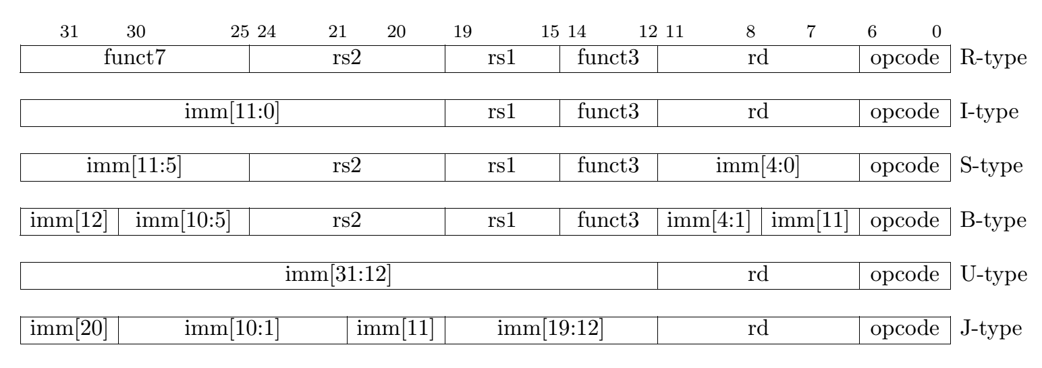
Instruction set
The instruction set of RISC-V can be divided into many groups. The most basic one is the RV32I integer instruction set. It includes 47 instructions, which can be grouped into six types:
R-type: register-register
I-type: short immediates and loads
S-type: stores
B-type: conditional branches, a variation of S-type
U-type: long immediates
J-type: unconditional jumps, a variation of U-type

Slide 11
Standard Extensions
Name | Description | Version | Status | Instruction Count
M | For Integer Multiplication and Division | 2.0 | Frozen | 8
A | For Atomic Instructions | 2.0 | Frozen | 11
F | For Single-Precision Floating-Point | 2.0 | Frozen | 25
D | For Double-Precision Floating-Point | 2.0 | Frozen | 25
G | Shorthand for the base and above extensions | N/A | N/A | N/A
Q | For Quad-Precision Floating-Point | 2.0 | Frozen | 27
L | For Decimal Floating-Point | 0.0 | Frozen | N/A
C | For Compressed Instructions | 2.0 | Frozen | 36
B | For Bit Manipulation | 0.9 | Frozen | 42
J | For Dynamically Translated Languages | 0.0 | Frozen | N/A
T | For Transactional Memory | 0.0 | Frozen | N/A
P | For Packed-SIMD Instructions | 0.1 | Frozen | N/A
V | For Vector Operations | 0.7 | Frozen | 186
N | For User-Level Interrupts | 1.1 | Frozen | 3
H | For Hypervisor | 0.0 | Frozen | 2
S | For Supervisor-level Instructions | 1.12 | Frozen | 7
By default, only the core ISA must be implemented presenting great opportunity for area and energy optimization. However, additional functionality is sometimes desired. RISC-V comes with a series of standard extensions that enable additional functionality beyond the core ISA such as floating point and operations and bit manipulation. Extensions can be implemented and omitted as desired. Those extensions are:

Slide 12
Calling Convention
The RISC-V calling convention specifies the rules for how functions should be called and returned from in programs compiled for RISC-V processors. These rules include details such as how function arguments are passed, where return values are stored, and the register usage conventions for different types of functions. It is important for a calling convention to be followed consistently within a program to ensure that function calls and returns work correctly. The RISC-V calling convention is designed to be simple and efficient, with a focus on minimizing the number of registers that need to be saved and restored during function calls.

Slide 13
Naming Convention
RISC-V defines an exact order that must be used to define the RISC-V ISA subset: RV [ 32, 64, 128] I,M,A,F,D,G,Q,L,C,B,J,T,P,V,N For example, RV32EMAB is legal, whereas RV32EMBA is not.
A complete RISC-V core designation gives the base specification appended with the letters of the standard extensions it implements, in the order listed in Figure 1. A small SoC using minimal resources, then, might have the designation RV32EMAB. This means the core implements the 32-bit integer instruction set for embedded devices, has 16 registers and runs integer multiplication and division as well as atomic instructions. It has no floating-point math but does support bit manipulation.

Slide 14
Conclusion
In conclusion, from what I learned here is that RISC-V is a open source Instruction Set Architecture (ISA) that has gained widespread adoption due to its modularity, extensibility, and flexibility. It has a large and growing user base in academia and industry, with a strong ecosystem of tools, software, and hardware support. It has many potential to disrupt the traditional ISA market and enable a new era of innovation in computer architecture. And I personally think that he reason many developers are fond of RISC-V is that it simplifies the instructions given to the processor to accomplish tasks and provides the flexibility to create thousands of possible custom processors. Thus significantly enables companies to get their designs to market faster.

Slide 15
SOURCES
https://www.allaboutcircuits.com/technical-articles/introductions-to-risc-v-instruction-set-understanding-this-open-instruction-set-architecture/
https://github.com/riscv2os/riscv2os/wiki/riscvOverview
https://www.elprocus.com/risc-v-processor/
https://devopedia.org/risc-v-instruction-sets#summary
https://www.digikey.com/en/blog/unlock-the-risc-v-naming-code

